Slide 1


ACCENTURE-
DATA ANALYST

Slide 2


Today's agenda
Project recap
Problem
The Analytics team
Process
Insights
Summary

Slide 3

Social Buzz founded by ex-engineers from a social media company, focusing on content-driven platform.
Users stay anonymous, 100+ reaction options shape trending content on user feeds.
Reached 500M active users monthly, needs advisory firm for scaling & IPO.
Enormous data collection requires tech-savvy team to manage 100K daily posts.
Seeking external expertise for IPO guidance, resource management & big data insights.
Engaged in a 3-month project for big data audit, IPO recommendations & top content categories.
Project Recap

Slide 4


Problem
Tasks to be delegated:
Create up-to-date big data best practices presentation.
Extract sample data sets using SQL.
Conduct on-site data-center audit.
Merge sample data set tables.
Conduct virtual session with Social Buzz team to present relevant client success stories.
Prepare best practice document for IPO.
Load sample data sets into Accenture sandbox database.
Conduct technology architecture workshop with Social Buzz Data Team.
Perform stress testing of technology to identify weak spots.
Communicate with previous IPO companies within our client base for reference stories.
Analyze sample data sets with visualizations.
Provide full documentation of the process to guide them through the IPO.

Slide 5



The Analytics team

Slide 6
Process
1
Data Understanding
2
Data Cleaning
3
Data Modelling
4
Data Analysis
5
Uncover Insights

Slide 7

Insights
16
16
940
No Of Category
No Of Reaction Types
No Of Unique Values In Sentiments

Slide 8
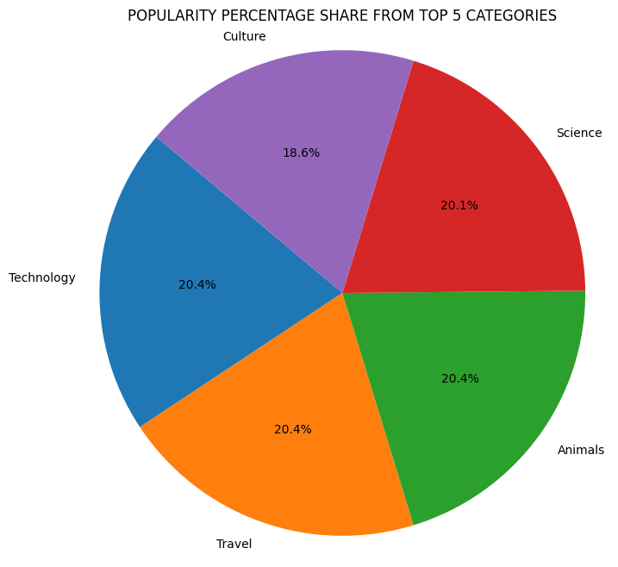
Notes:
Additionally, you can see from this chart the % split of popularity between the top 5 categories. There is not much difference between each of them.

Slide 9
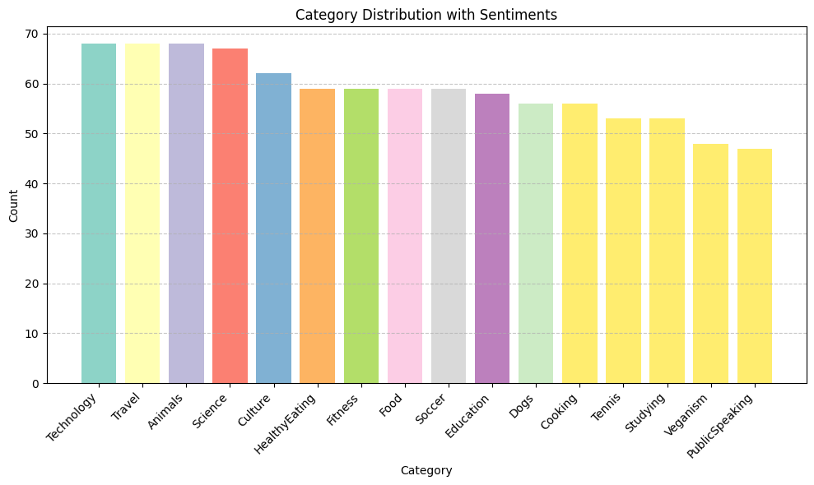

Slide 10

Key Points
1. Identify popular categories: Travel, Technology, and Animals have the highest occurrences.
2. Top reactions matter: "Adore" and "Heart" are the most prevalent reactions users express.
3. Sentiment distribution: Majority of reviews are positive (553), followed by negative (279) and neutral (108).
4. Actionable insights: Use data to improve user engagement and optimize the user experience.
5. Focus on user preferences: Understand what users adore and heart to tailor content accordingly.
6. Enhance negative feedback: Address and respond to negative feedback to improve customer satisfaction.
7. Encourage positive reviews: Leverage positive sentiments to build brand loyalty and word-of-mouth promotion.
Summary

Slide 11

Thank you!
ANY QUESTIONS?

